Slide 1
Chino Basin Watermaster
Role of the board and committees
Board workshop
May 26, 2022

Slide 2
Workshop Goals
Improve understanding of:
The relationship between the Pool Committees, AC, and the Board
The different types of actions and decisions that the Board could make

Slide 3
Watermaster and Advisory Committee Respective Roles
 | I. Watermaster Board Duties and Powers | II. Watermaster Board Discretionary Function | III. Upon Advisory Committee Recommendation or Advice, or Pool Committee Requirement | IV. Other Watermaster Functions
Type of Actions | Administer, Enforce & Implement the Judgment and Physical Solution. Examples: Control and regulate storage Establish procedures and administer withdrawal and supplemental water replenishment Steward the Basin’s resources | Develop an Optimum Basin Management Program | Recommendation or advice on items like: Adoption of rules and regulations; Acting jointly with other agencies of the United States or the State of California Adoption of administrative budget Levy and collect annual assessments Required actions like: Allocation of special project expenses | Normal Course of Business Examples: Acquire facilities and equipment Employ or retain staff and consultants Administering the Pools Levy and collect annual assessments Administering the Physical Solution Example: Accomplish replenishment of overproduction
Pools and Advisory Committee Role | Advice and assistance | Advice and assistance | Recommendation or Advice; approval required; OR Required Action; approval required | Advice
Watermaster Board Role | Approval; must notify the Advisory Committee | Approval; must notify the Advisory Committee | Watermaster must act consistently with an AC recommendation that has been approved by 80 or more votes, but has the right to bring the issue before the Court. In case an AC recommendation does not have the 80 vote mandate, Watermaster may take a different action after a public hearing followed by written findings and a decision. | Approval; must notify the Advisory Committee
The above table is a brief summary; the full text can be found in Part III of Special Referee Report and Recommendation entitled “Watermaster Roles and Review of Watermaster Actions” found on pages 10 through 22. This was adopted and incorporated by the Court in its February 19, 1998 Order establishing the nine-member Watermaster Board

Slide 4
I. Watermaster Board Duties and Powers
Type of Actions | Administer, Enforce & Implement the Judgment and Physical Solution. Examples: Control and regulate storage Establish procedures and administer withdrawal and supplemental water replenishment Steward the Basin’s resources
Pools and Advisory Committee Role | Advice and assistance
Watermaster Board Role | Approval; must notify the Advisory Committee
Appears on Staff Reports as | [Within WM Duties and Powers]

Slide 5
Examples
Water transfers and water transactions
Storage Agreements
Recharge applications
Reports to regulatory bodies

Slide 6
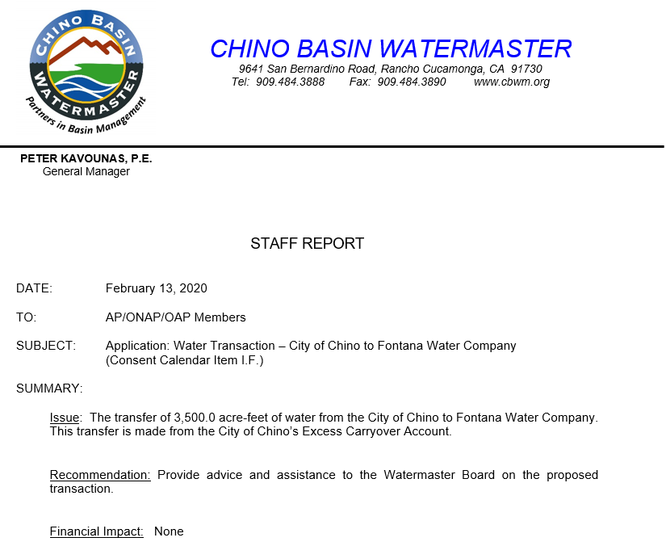
I. Watermaster Board Duties and Powers
Example (Pools):

Slide 7
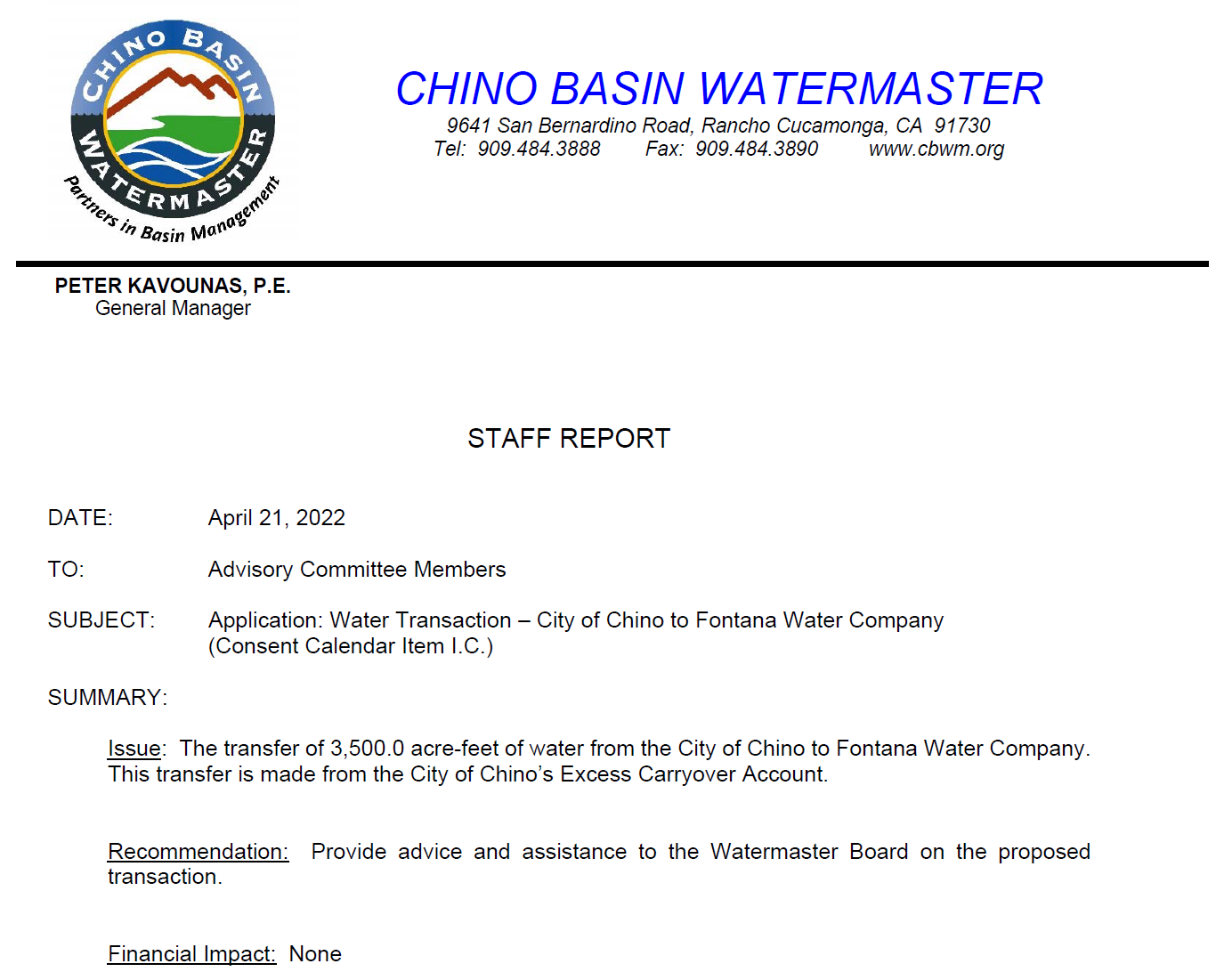
I. Watermaster Board Duties and Powers
Example (AC):

Slide 8
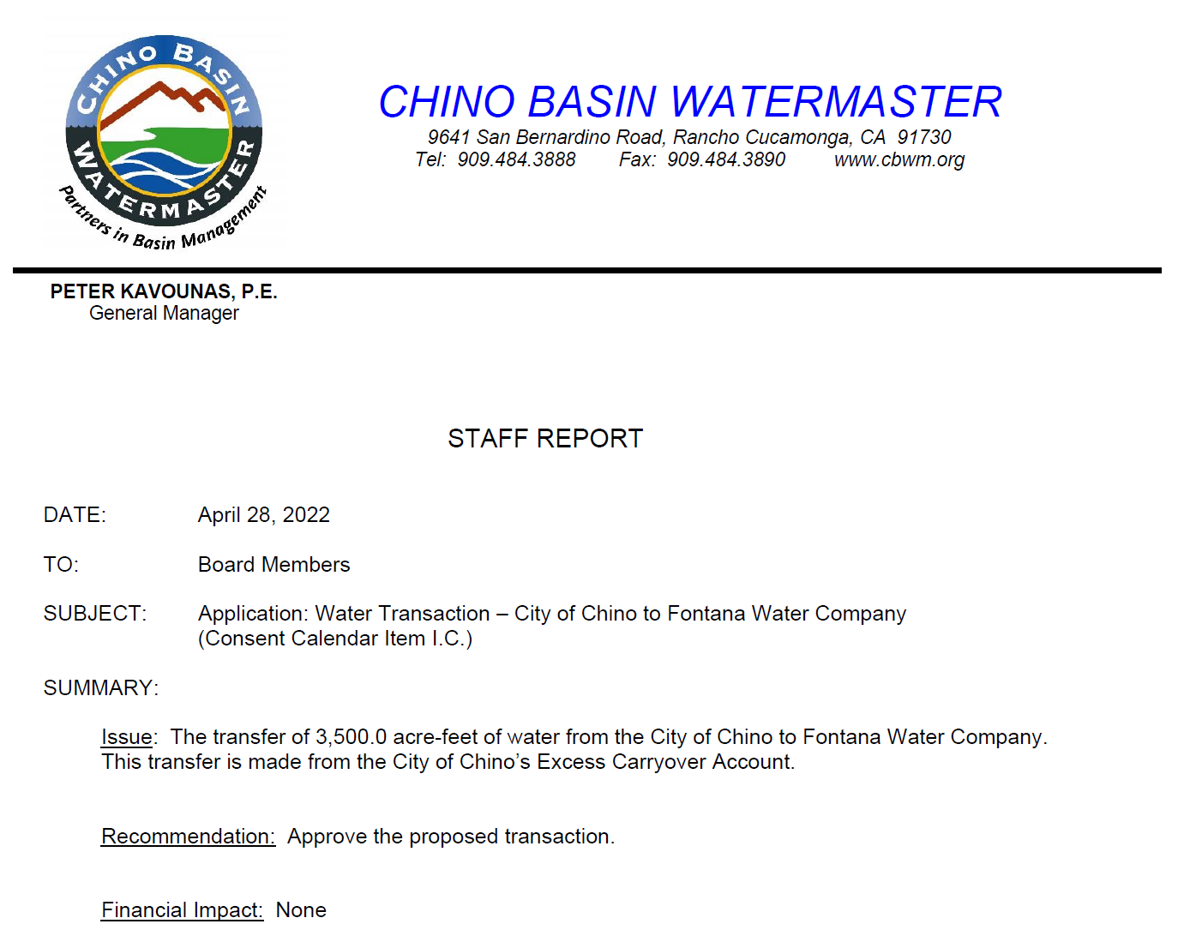
I. Watermaster Board Duties and Powers
Example (Board):

Slide 9
Watermaster and Advisory Committee Respective Roles
 | I. Watermaster Board Duties and Powers | II. Watermaster Board Discretionary Function | III. Upon Advisory Committee Recommendation or Advice, or Pool Committee Requirement | IV. Other Watermaster Functions
Type of Actions | Administer, Enforce & Implement the Judgment and Physical Solution. Examples: Control and regulate storage Establish procedures and administer withdrawal and supplemental water replenishment Steward the Basin’s resources | Develop an Optimum Basin Management Program | Recommendation or advice on items like: Adoption of rules and regulations; Acting jointly with other agencies of the United States or the State of California Adoption of administrative budget Levy and collect annual assessments Required actions like: Allocation of special project expenses | Normal Course of Business Examples: Acquire facilities and equipment Employ or retain staff and consultants Administering the Pools Levy and collect annual assessments Administering the Physical Solution Example: Accomplish replenishment of overproduction
Pools and Advisory Committee Role | Advice and assistance | Advice and assistance | Recommendation or Advice; approval required; OR Required Action; approval required | Advice
Watermaster Board Role | Approval; must notify the Advisory Committee | Approval; must notify the Advisory Committee | Watermaster must act consistently with an AC recommendation that has been approved by 80 or more votes, but has the right to bring the issue before the Court. In case an AC recommendation does not have the 80 vote mandate, Watermaster may take a different action after a public hearing followed by written findings and a decision. | Approval; must notify the Advisory Committee
The above table is a brief summary; the full text can be found in Part III of Special Referee Report and Recommendation entitled “Watermaster Roles and Review of Watermaster Actions” found on pages 10 through 22. This was adopted and incorporated by the Court in its February 19, 1998 Order establishing the nine-member Watermaster Board

Slide 10
II. Watermaster Board Discretionary Function
Type of Actions | Develop an Optimum Basin Management Program
Pools and Advisory Committee Role | Advice and assistance
Watermaster Board Role | Approval; must notify the Advisory Committee
Appears on Staff Reports as | [Discretionary Function]

Slide 11
Examples
OBMP Semi-Annual Report
Ground Level Monitoring Committee Report
2020 OBMP Update

Slide 12
II. Watermaster Board Discretionary Function
Example:

Slide 13
Watermaster and Advisory Committee Respective Roles
 | I. Watermaster Board Duties and Powers | II. Watermaster Board Discretionary Function | III. Upon Advisory Committee Recommendation or Advice, or Pool Committee Requirement | IV. Other Watermaster Functions
Type of Actions | Administer, Enforce & Implement the Judgment and Physical Solution. Examples: Control and regulate storage Establish procedures and administer withdrawal and supplemental water replenishment Steward the Basin’s resources | Develop an Optimum Basin Management Program | Recommendation or advice on items like: Adoption of rules and regulations; Acting jointly with other agencies of the United States or the State of California Adoption of administrative budget Levy and collect annual assessments Required actions like: Allocation of special project expenses | Normal Course of Business Examples: Acquire facilities and equipment Employ or retain staff and consultants Administering the Pools Levy and collect annual assessments Administering the Physical Solution Example: Accomplish replenishment of overproduction
Pools and Advisory Committee Role | Advice and assistance | Advice and assistance | Recommendation or Advice; approval required; OR Required Action; approval required | Advice
Watermaster Board Role | Approval; must notify the Advisory Committee | Approval; must notify the Advisory Committee | Watermaster must act consistently with an AC recommendation that has been approved by 80 or more votes, but has the right to bring the issue before the Court. In case an AC recommendation does not have the 80 vote mandate, Watermaster may take a different action after a public hearing followed by written findings and a decision. | Approval; must notify the Advisory Committee
The above table is a brief summary; the full text can be found in Part III of Special Referee Report and Recommendation entitled “Watermaster Roles and Review of Watermaster Actions” found on pages 10 through 22. This was adopted and incorporated by the Court in its February 19, 1998 Order establishing the nine-member Watermaster Board

Slide 14
III. Upon Advisory Committee Recommendation or Advice, or Pool Committee Requirement
Type of Actions | Recommendation or advice on items like: Adoption of rules and regulations; Acting jointly with other agencies of the United States or the State of California Adoption of administrative budget Levy and collect annual assessments Required actions like: Allocation of special project expenses
Pools and Advisory Committee Role | Recommendation or Advice; approval required; OR Required Action; approval required
Watermaster Board Role | Watermaster must act consistently with an AC recommendation that has been approved by 80 or more votes, but has the right to bring the issue before the Court. In case an AC recommendation does not have the 80 vote mandate, Watermaster may take a different action after a public hearing followed by written findings and a decision.
Appears on Staff Reports as | [Advisory Committee Approval Required]

Slide 15
Examples
Adoption of the Budget
Agreements and Task Orders with Municipal Water Districts (IEUA, WMWD, TVMWD)
Budget Amendments and Budget Transfers
Reappointment of the Watermaster Board

Slide 16
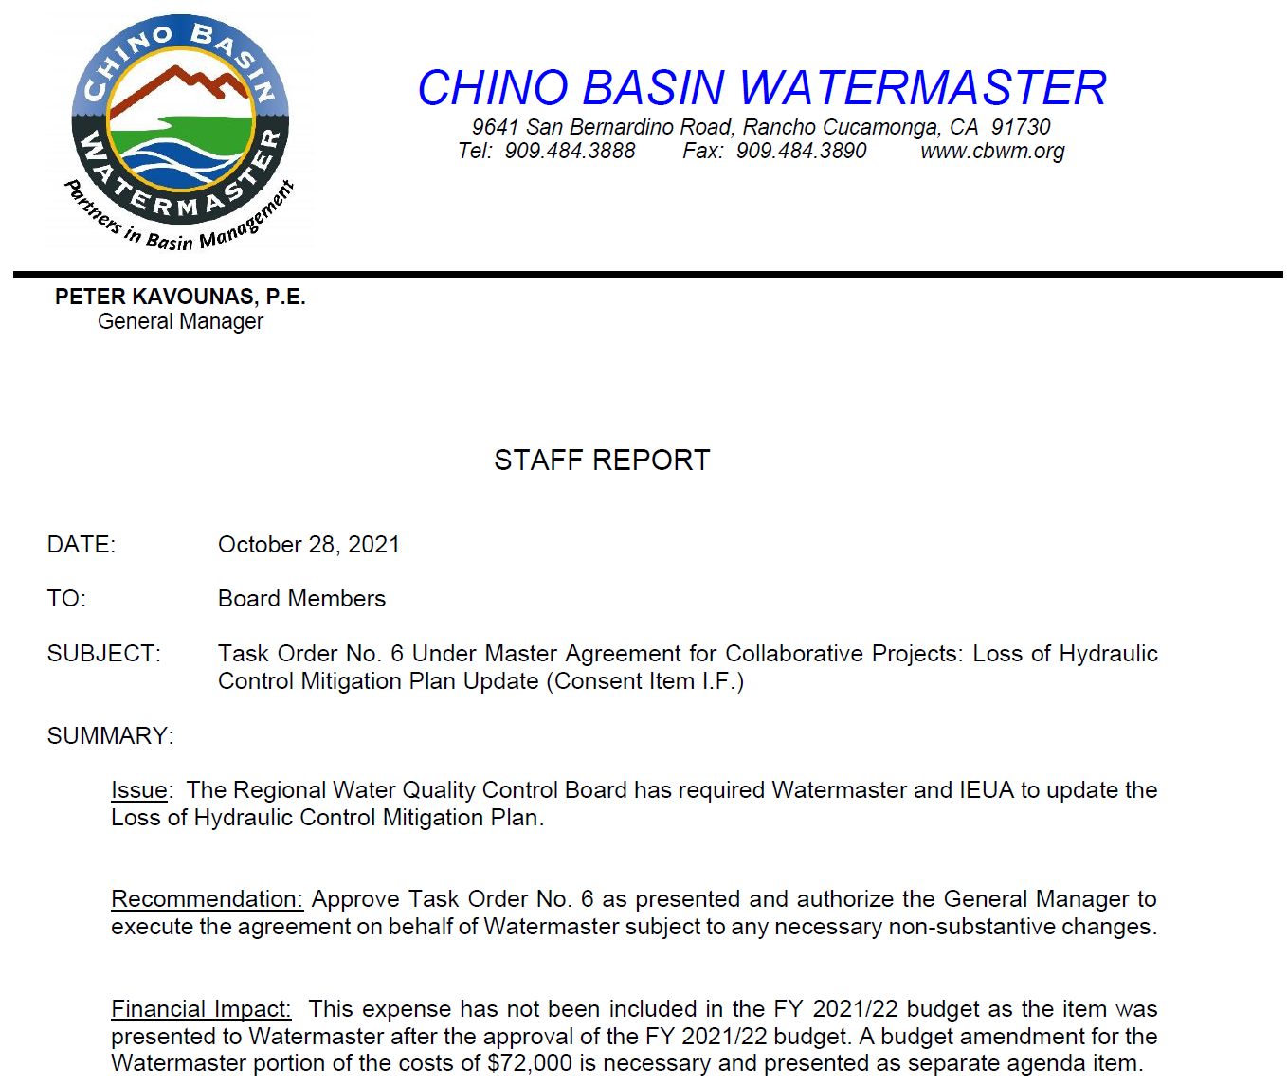
III. Upon Advisory Committee Recommendation or Advice, or Pool Committee Requirement
Example:

Slide 17
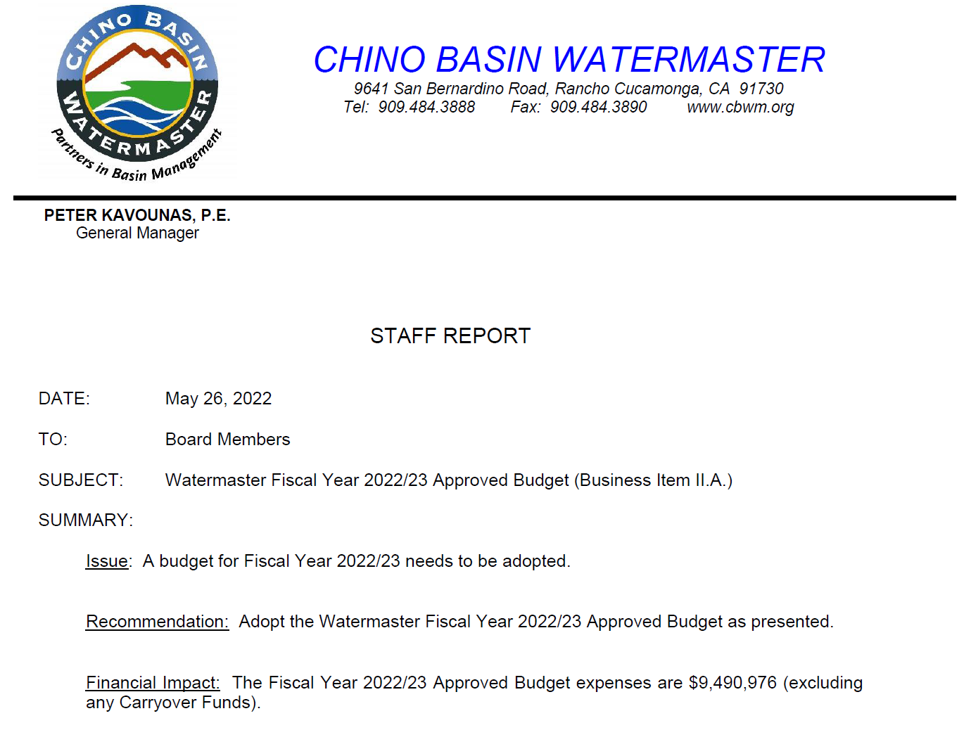
III. Upon Advisory Committee Recommendation or Advice, or Pool Committee Requirement
Example:

Slide 18
Watermaster and Advisory Committee Respective Roles
 | I. Watermaster Board Duties and Powers | II. Watermaster Board Discretionary Function | III. Upon Advisory Committee Recommendation or Advice, or Pool Committee Requirement | IV. Other Watermaster Functions
Type of Actions | Administer, Enforce & Implement the Judgment and Physical Solution. Examples: Control and regulate storage Establish procedures and administer withdrawal and supplemental water replenishment Steward the Basin’s resources | Develop an Optimum Basin Management Program | Recommendation or advice on items like: Adoption of rules and regulations; Acting jointly with other agencies of the United States or the State of California Adoption of administrative budget Levy and collect annual assessments Required actions like: Allocation of special project expenses | Normal Course of Business Examples: Acquire facilities and equipment Employ or retain staff and consultants Administering the Pools Levy and collect annual assessments Administering the Physical Solution Example: Accomplish replenishment of overproduction
Pools and Advisory Committee Role | Advice and assistance | Advice and assistance | Recommendation or Advice; approval required; OR Required Action; approval required | Advice
Watermaster Board Role | Approval; must notify the Advisory Committee | Approval; must notify the Advisory Committee | Watermaster must act consistently with an AC recommendation that has been approved by 80 or more votes, but has the right to bring the issue before the Court. In case an AC recommendation does not have the 80 vote mandate, Watermaster may take a different action after a public hearing followed by written findings and a decision. | Approval; must notify the Advisory Committee
The above table is a brief summary; the full text can be found in Part III of Special Referee Report and Recommendation entitled “Watermaster Roles and Review of Watermaster Actions” found on pages 10 through 22. This was adopted and incorporated by the Court in its February 19, 1998 Order establishing the nine-member Watermaster Board

Slide 19
Examples
Hiring and retaining consultants
Hiring staff
Acquiring equipment
Levy and collect assessments
Replenish overproduction

Slide 20
IV. Other Watermaster Functions
Type of Actions | Normal Course of Business Examples: Acquire facilities and equipment Employ or retain staff and consultants Administering the Pools Levy and collect annual assessments Administering the Physical Solution Example: Accomplish replenishment of overproduction
Pools and Advisory Committee Role | Advice
Watermaster Board Role | Approval; must notify the Advisory Committee
Appears on Staff Reports as | [Normal Course of Business]

Slide 21
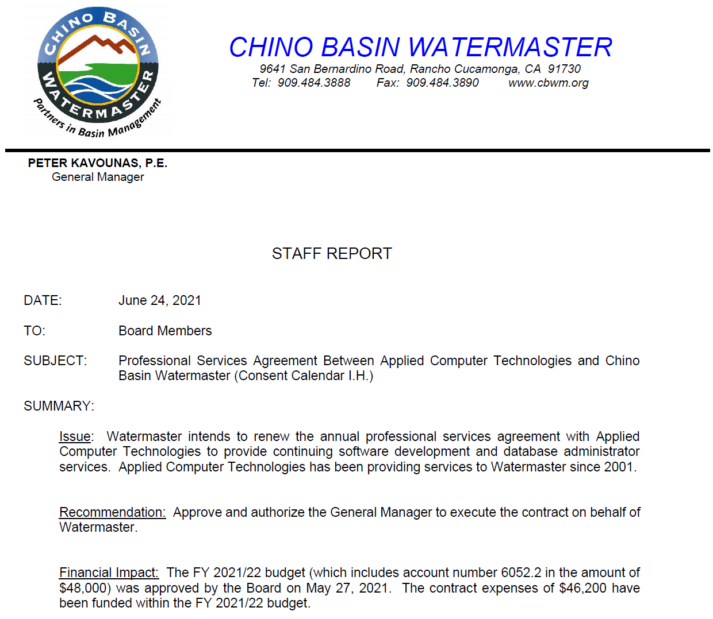
IV. Other Watermaster Functions
Example:

Slide 22
Quiz

Slide 23
Instructions
You will be presented with real life examples of items that have come to the Board for action
For each item you will be asked to write on your paddle board:
If you know the category of the item (I, II, III, or IV) please write the role of the Pools and Advisory committee:
Pools: Advice and Assistance (A&A)
AC: Advice and Assistance (A&A) or Approval
If you know the actions taken by Pools and AC, please write the category (I, II, III, or IV)

Slide 24
Get ready!

Slide 25
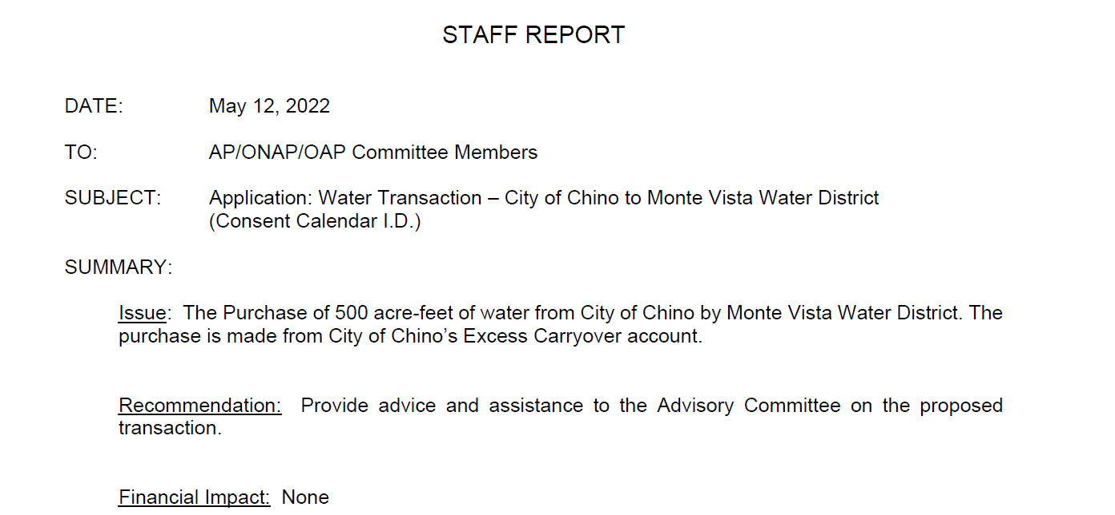

Slide 26
Correct Answer:
I. Watermaster Board Duties and Powers

Slide 27
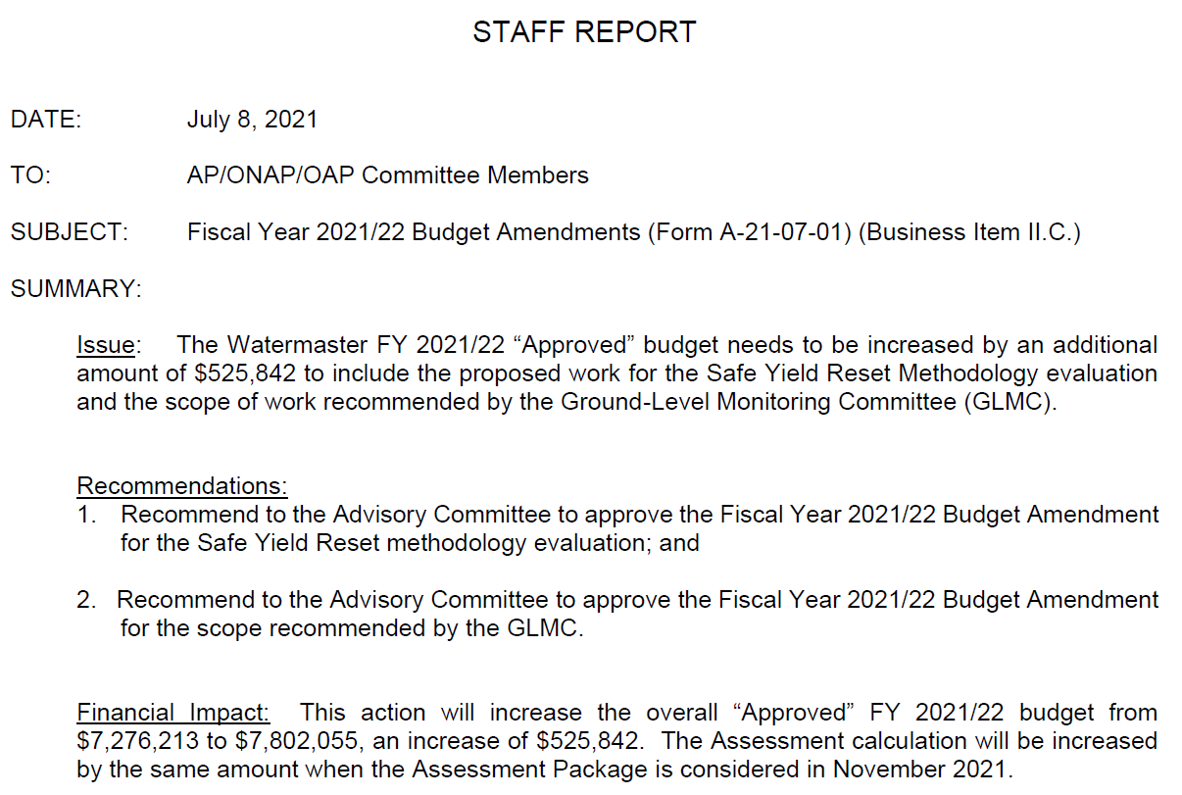

Slide 28
Correct Answer:
Pools: Advice and Assistance ( A&A )
AC: Approval

Slide 29
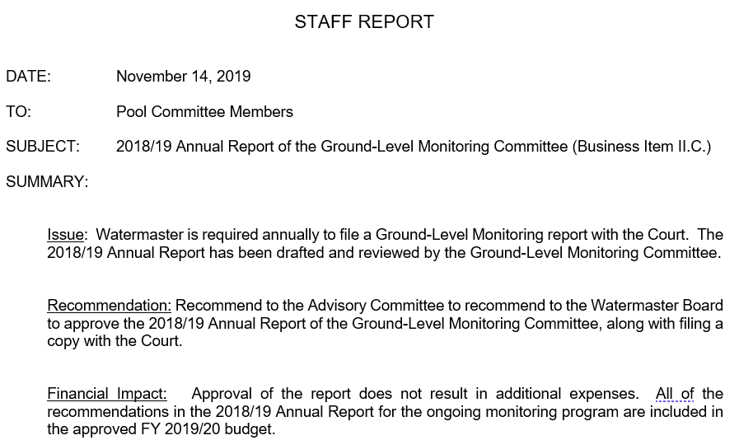

Slide 30
Correct Answer:
II. Watermaster Board Discretionary Function

Slide 31
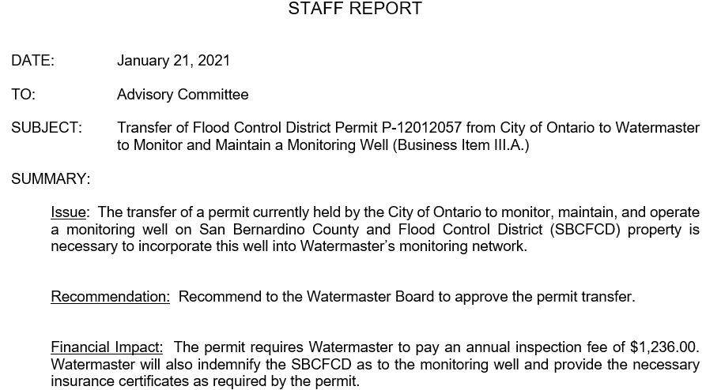

Slide 32
Correct Answer:
IV. Other Watermaster Functions

Slide 33
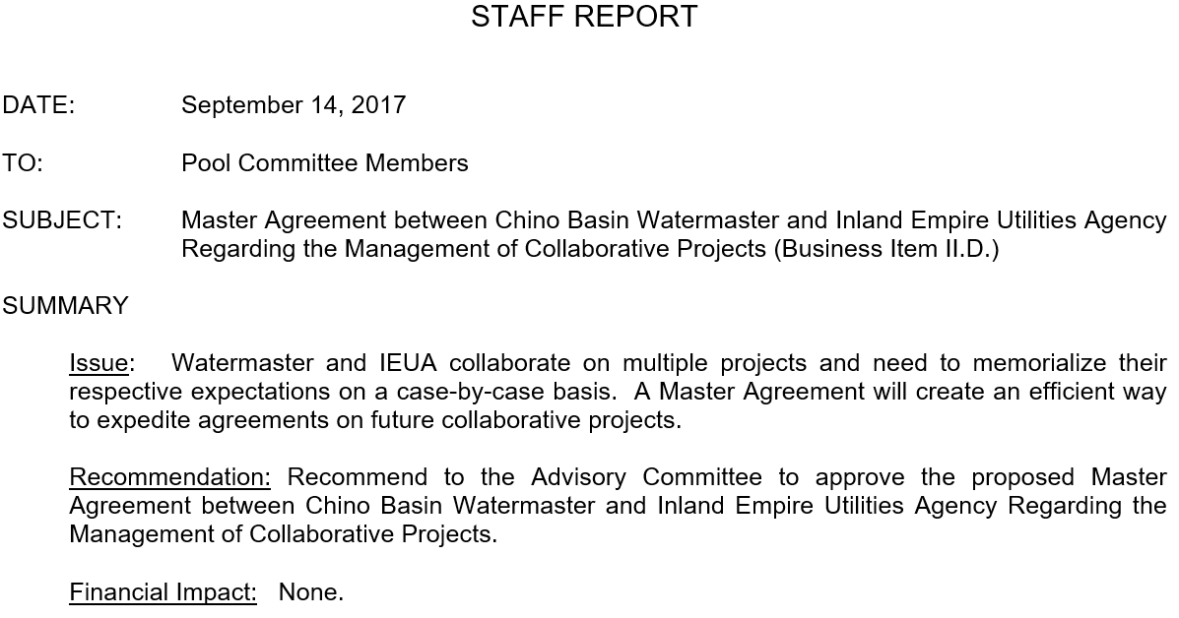

Slide 34
Correct Answer:
III. Upon Advisory Committee Recommendation or Advice, or Pool Committee Requirement

Slide 35
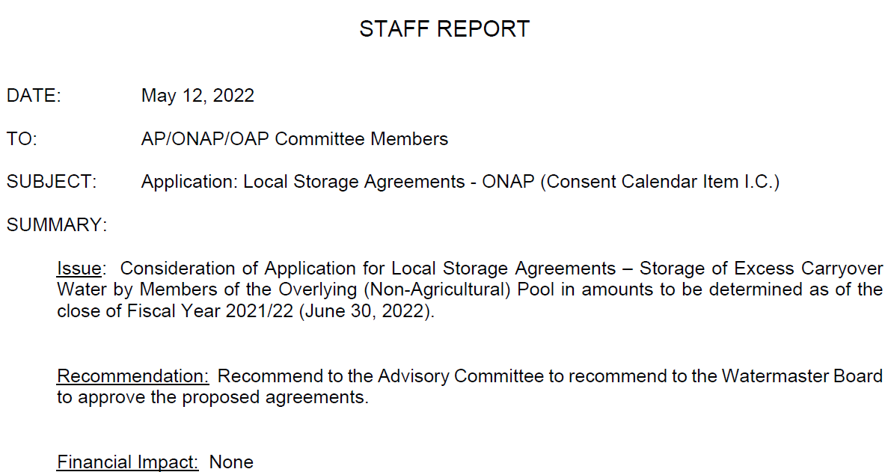

Slide 36
Correct Answer:
I. Watermaster Board Duties and Powers

Slide 38
Correct Answer:
Pools and AC: Advice and Assistance (A&A)

Slide 39
Discussion & Questions

Slide 40
Thanks for participating!

