Slide 1
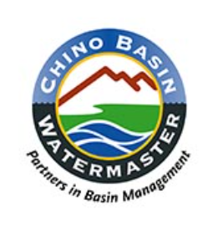
2021 California Groundwater Issues Virtual Conference February 9th and 10th, 2021 Association of Ground Water Agencies and American Ground Water Trust Presented by: Shivaji Deshmukh, General Manager, Inland Empire Utilities Agency Peter Kavounas, General Manager, Chino Basin Watermaster
MANAGING SALINITY IN THE CHINO GROUNDWATER BASIN
A TRUE REGIONAL PARTNERSHIP

Slide 2
Presentation Outline
Regional Cooperation to manage salinity through Max Benefit
Regional use of recycled water enabled by Max Benefit
Adaptive regulation for long term regional salinity management

Slide 3
Basin setting

Slide 4
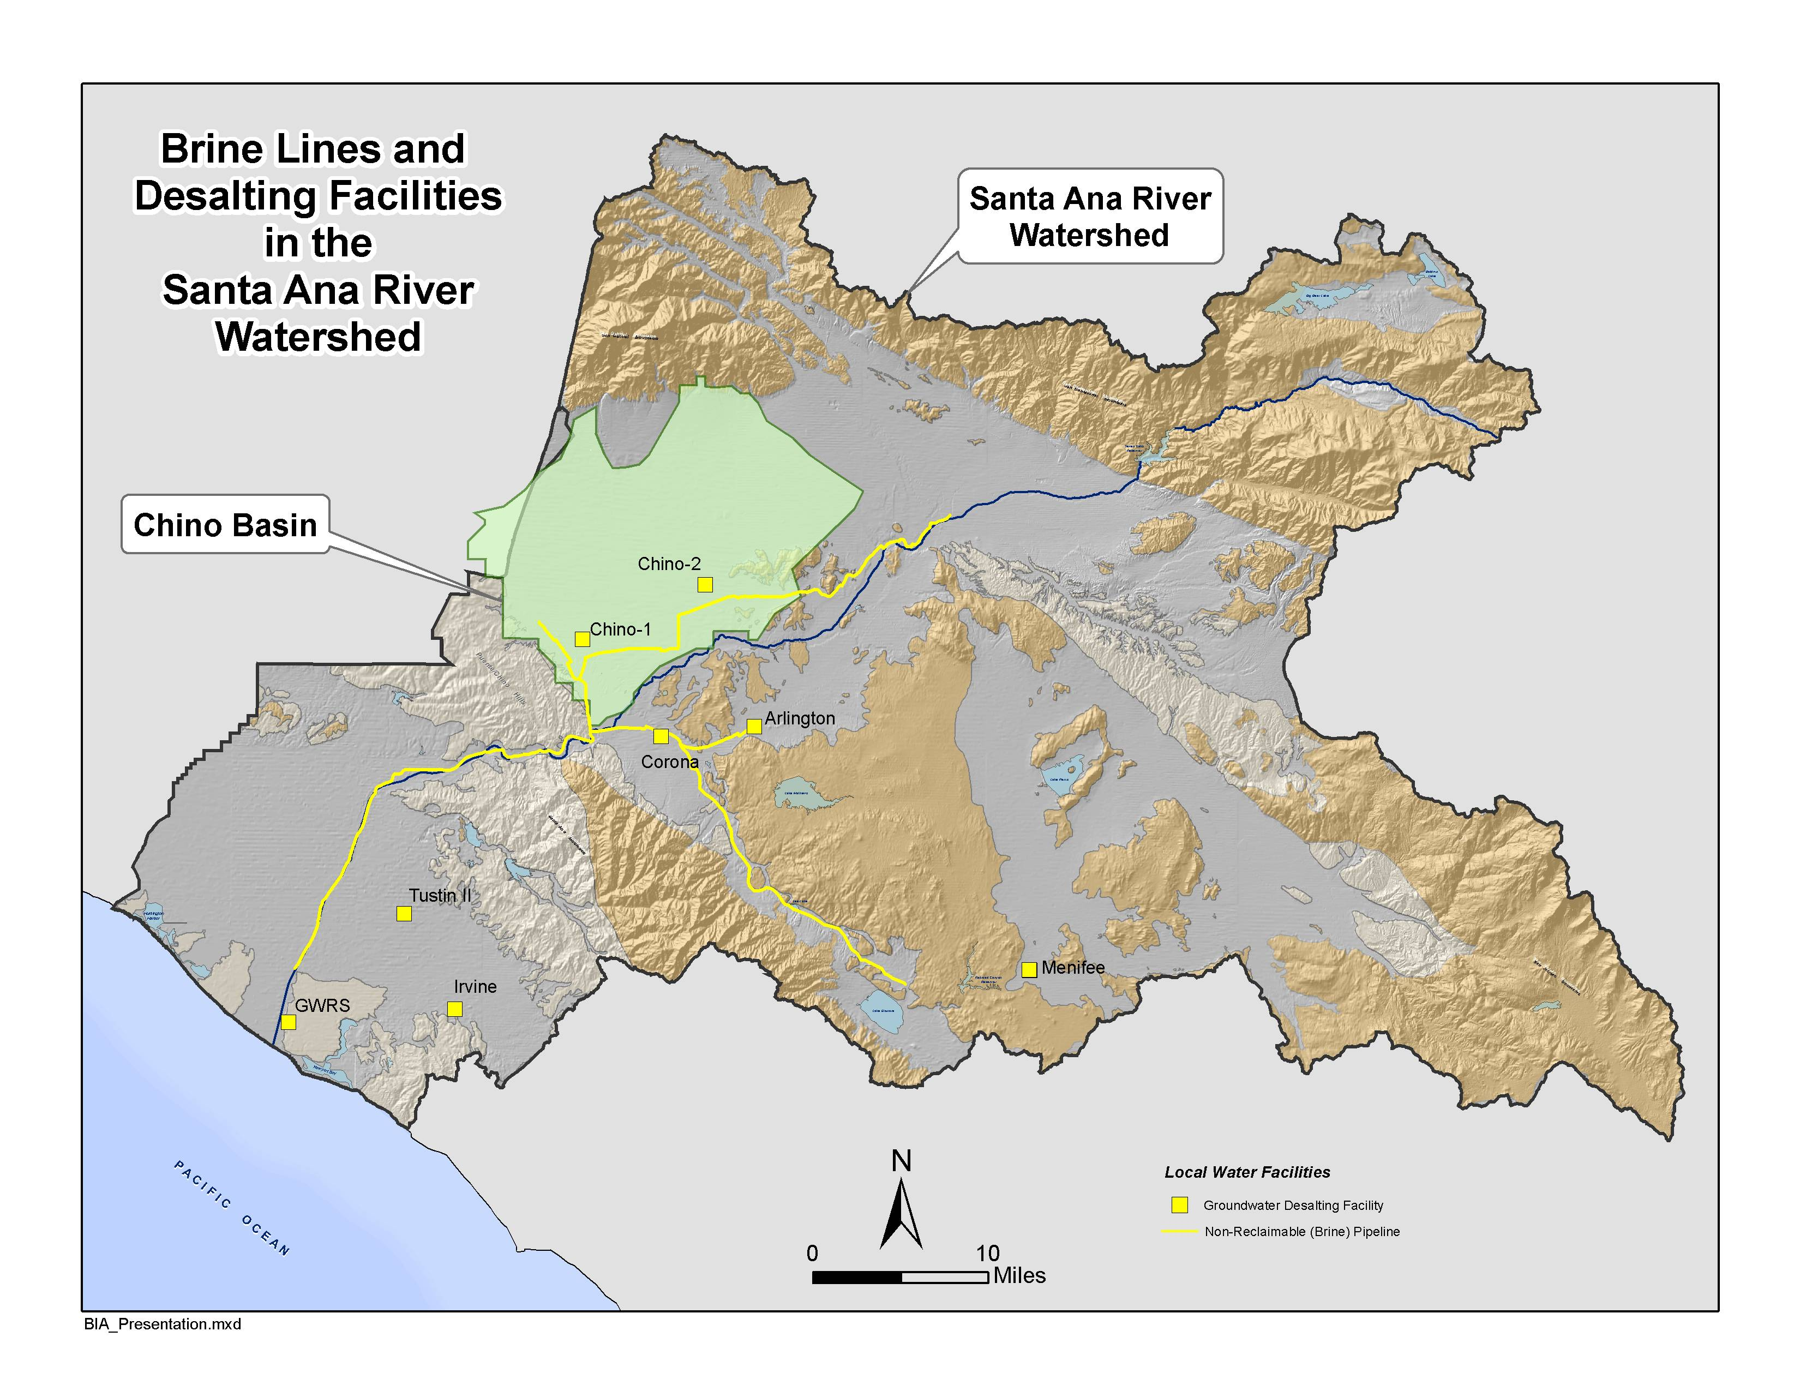
Basin setting

Slide 5
Description of Stakeholders
Groundwater Pumpers (farmers, industry, retail water agencies)
Wastewater treatment agencies
Imported water agencies
Santa Ana Watershed Project Authority
Regional Water Quality Control Board

Slide 6
Regional Cooperation to manage salinity through Max Benefit
By: Peter Kavounas

Slide 7
Basin Plan Amendment From this:

Slide 8
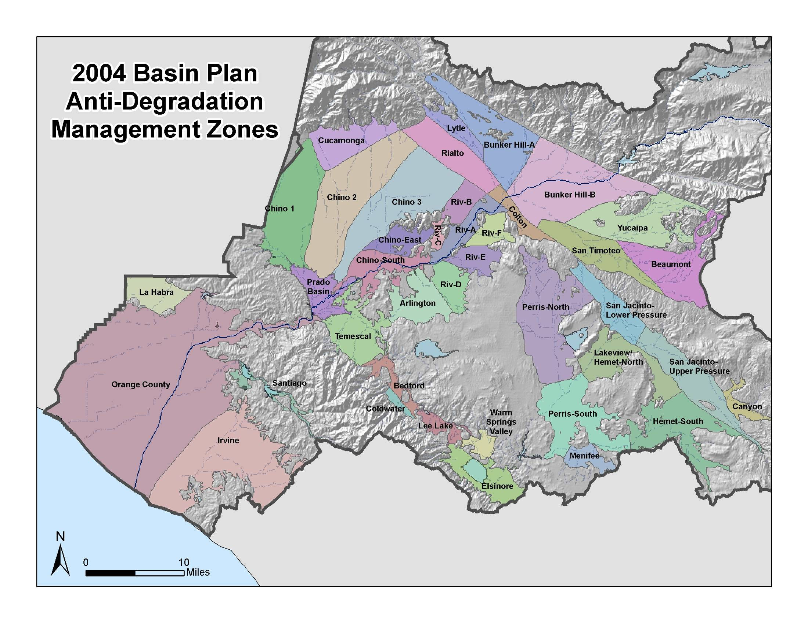
Basin Plan Amendment To this:

Slide 9
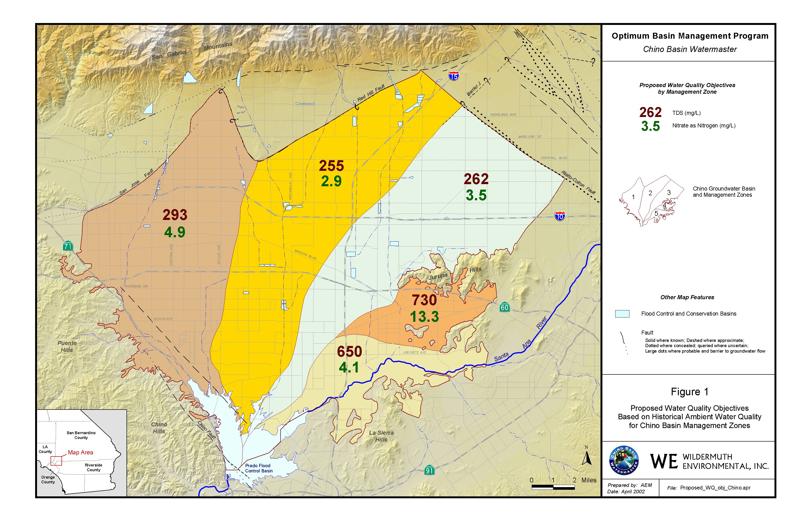
TDS/N Limits From this:

Slide 10
TDS/N Limits To this:
Chino Desalter
Wellfield

Slide 11
“Maximum Benefit”
Combine Chino-1, Chino-2, Chino-3 management zones into Chino-North
Current ambient TDS for Chino-North was 330 mg/L
The “Maximum Benefit” TDS objective needed to be greater than 330 mg/L to create assimilative capacity
Assimilative capacity provides the Regional Board with discretionary authority to permit discharges that exceed the objective

Slide 12
“Maximum Benefit”
Regional commitments:
Annual Reporting
Ongoing monitoring and analysis
Expansion of the Chino Desalters
Expansion of artificial recharge facilities
Blending of recycled water
Wastewater improvement plan
“Hydraulic Control” to protect downstream uses
Regional benefits:
Higher TDS/Nitrogen limits
Ongoing salt removal
Fresh water supply
Increased yield of the groundwater basin, and
Ability to recharge recycled water without further treatment

Slide 13
Regional use of recycled water enabled by Maximum Benefit
By: Shivaji Deshmukh

Slide 14
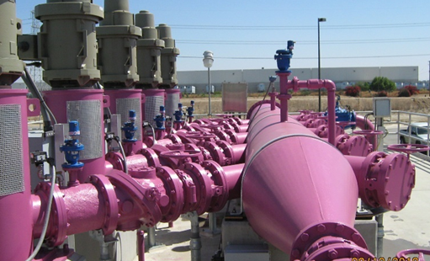
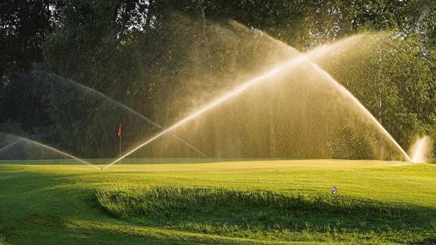
IEUA’s Recycled Water Program
RW to El Prado Park
RW to Whispering Lakes & El Prado Golf Course
Installed distribution system in Chino/Chino Hills
First Regional Pipeline
Groundwater recharge with recycled water at Ely Basin
Recycled Water Feasibility Study (2002)
Chino Basin Facilities Improvements – Recharge (2004)
Recycled Water Implementation Plan (2005)
Developed Three Year Business Plan (2007)
$650M in Capital Invested to Date
95 Miles of Regional Infrastructure Installed
1976
2000
2005
2020
Notes:
1970’s – IEUA began RW efforts by serving Whispering Lakes Golf Course, El Prado Golf Course* and El Prado Park in the Cities of Chino and Ontario
1990’s – Carbon canyon distribution system was constructed with individual agreements;
IEUA’s first regional pipeline was also constructed at this time
IEUA began to implement groundwater recharge with recycled water at Ely Basin (1999)
2000’s, the RW program has expanded delivery of high-quality RW for the region
In order to promote the use of RW, IEUA adopted policies developed plans to develop and increase the use of the recycled water and incentive agencies to connect to the RW system
2007 – To reach milestone objectives of maximizing MWD rebates and other grants, 3-YR Business Plan was created with unanimous support from member agencies to dramatically increase RW use
2020
Direct use is presently decreasing due to land use conversions from agricultural to residential and commercial use
However, RW GWR has continued to increase over time. We are currently on target to reach a record high of GWR, fingers crossed for 16 TAF in 20/21.

Slide 15
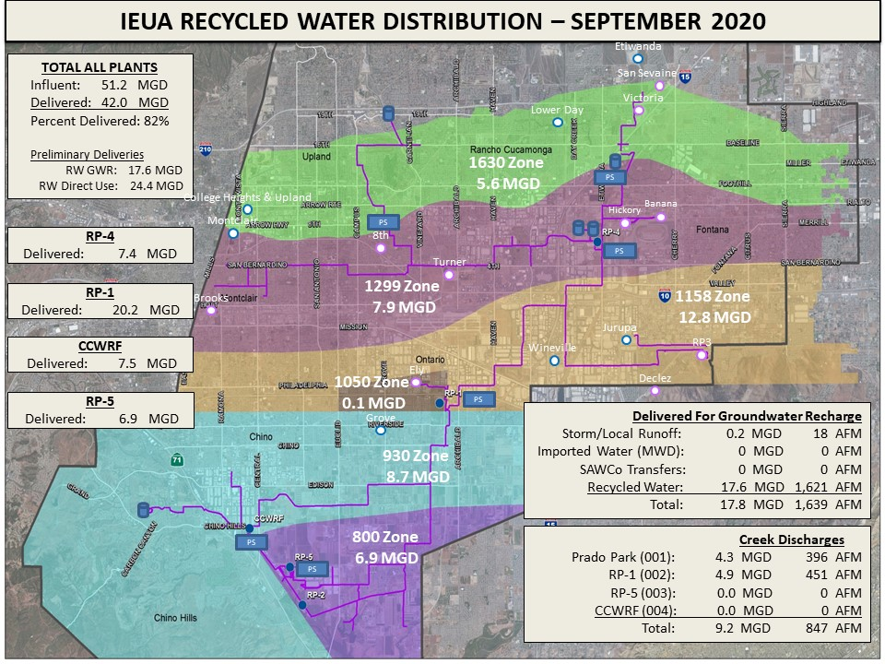
Recycled Water System
IEUA’s 4 regional water recycling plants produce approximately 50 MGD
Over 1,200 RW customer connections
Direct use for landscaping, agriculture, industrial use, etc.
Recharge in the Chino Basin
Discharge to the Santa Ana River
Groundwater Recharge Basins
Partners: SBCFCD, CBWCD, CBWM, IEUA
Recharge stormwater, imported and RW
21 recharge basins
13 basins permitted for RW recharge
Notes:
4 water recycling plants include RP-1, RP-4, RP-5, and CCWRF
RW is used for direct uses (landscape irrigation, farming); facilities built with regional collaboration
Partners: IEUA, San Bernardino County Flood Control District, Chino Basin Water Conservation District, and Chino Basin Watermaster (Watermaster)

Slide 16
Regional Recycled Water Use
RW use began increasing in the 1990’s as the regional distribution system began to expand
2010 marked the first significant jump in recharge of recycled water
Recently experiencing a decrease in direct use, with an increase in RW recharged
FY2020/21 is forecasting record RW groundwater recharge with recent facility upgrades

Slide 17
Groundwater Recharge Program
Regional hands-on program:
Multi-agency and multi-year planning and cooperation
Interagency flexibility: dry-year yield program (conjunctive use), agency transfers
Proactive management
Monitoring and reporting program
Recharging groundwater helps improve:
Surface water by reducing street runoff, sediment and debris load
Groundwater by reducing nitrates and TDS
Recharge has been increasingly successful
Chino Basin is a model for long-term success in groundwater management

Slide 18
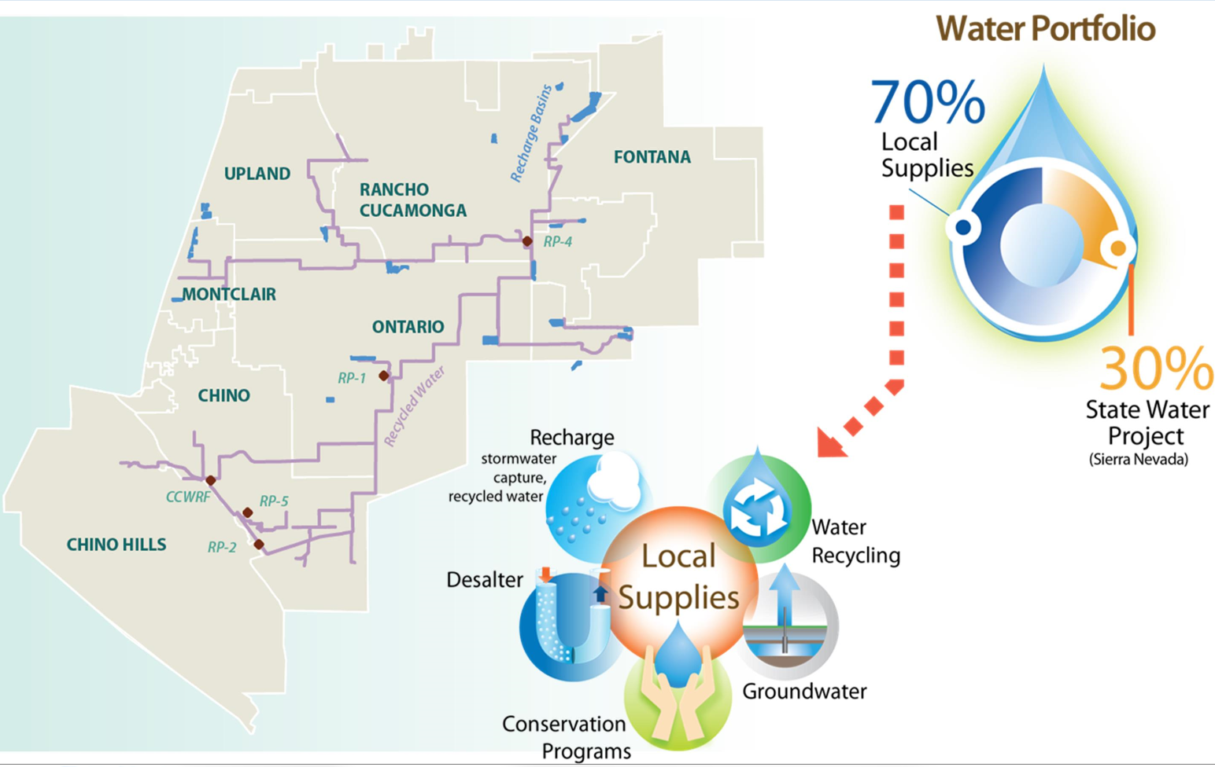
Regional Water Supplies
Regional water supplies includes both local and imported sources to meet demands
Local sources:
Surface water
Groundwater
Desalinated water
Recycled water
Imported sources:
State Water Project

Slide 19
Recycled Water Reuse
RW is ~15% of the local water supply
RW holds a critical role in the long-term water security of the region
Only new major source of water available to meet southern California’s growing water demands
Long-term increasing RW salinity trends
Increasing salinity trends pose a risk to the continued use of RW without advanced water purification
IEUA Service Area Water Use Portfolio
FY 2019-20

Slide 20
Adaptive regulation for long term regional salinity management
By: Shivaji Deshmukh

Slide 21
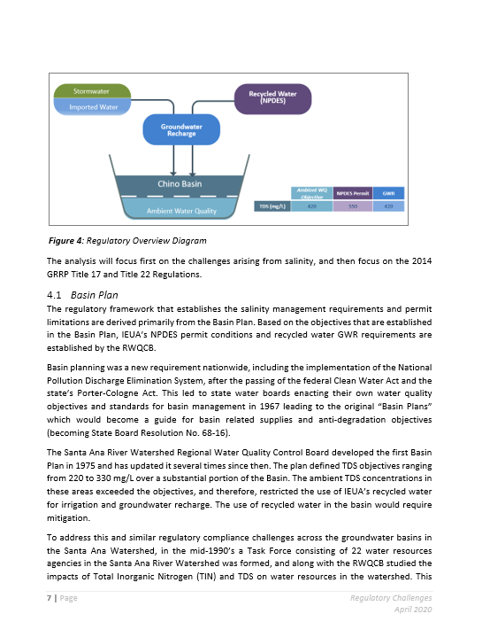
Regulatory Requirements
Water, recycled water & wastewater quality management in Chino Basin is governed by:
Basin Plan
IEUA NPDES Permit
GWR Permit
2014 Title 22 Groundwater Replenishment Regulations
Regulatory challenges for recycled water:
Salinity (TDS)
1,2,3-TCP
PFAS
Microplastics
Constituents of Emerging Concerns (CECs)

Slide 22
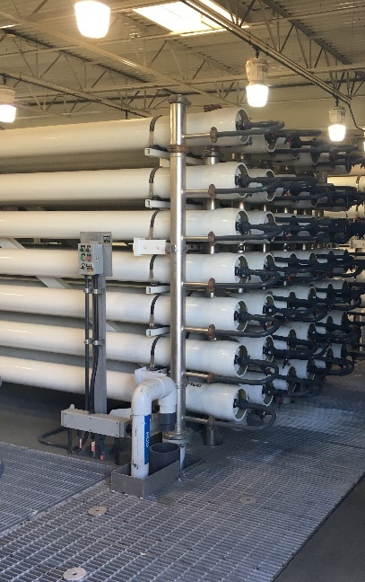
Long-Term Salinity Management
Over 15 years of major regional efforts:
Chino Basin Desalters
Self-generating water softener use ordinance
Brine line discharge requirements
Chemical use optimization in the WWTP
Securing high quality supplemental water
Challenges with TDS
Maximum Benefit requires a plan for treatment before exceeding limits
In 2014/15, RW TDS was within 10 mg/l of the limit
Drought, climate change, etc. further exacerbate TDS
IEUA and CBWM initiated a salinity management study
Notes:
The region has made commitments to implement regional programs to manage/reduce TDS
Maximum Benefit Plan enables use of RW
Non-Compliance with Maximum Benefit could prohibit use of RW

Slide 23
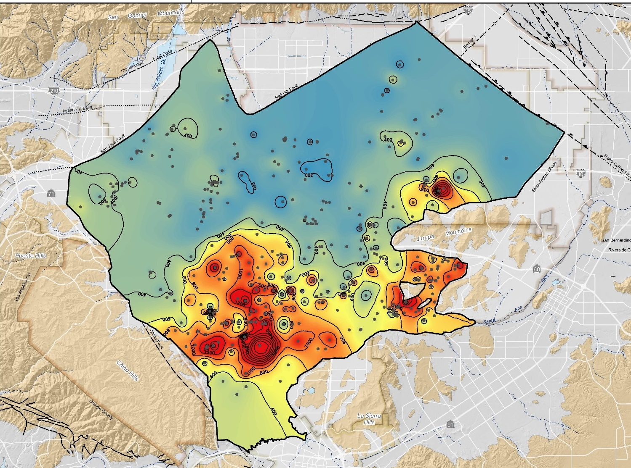
Adaptive Regulation
IEUA and CBWM initiated modeling and analysis in coordination with the Regional Water Quality Control Board (RWQCB)
Question at hand:
What are the impacts to groundwater quality in the Chino Basin if allowed a longer-term averaging period?
Will use the results to define an updated maximum benefit salinity management plan
Notes:
Current averaging period for TDS is a 12-month running average
Evaluating 5- and 10-year running averages to account for hydrologic and climate conditions

Slide 24
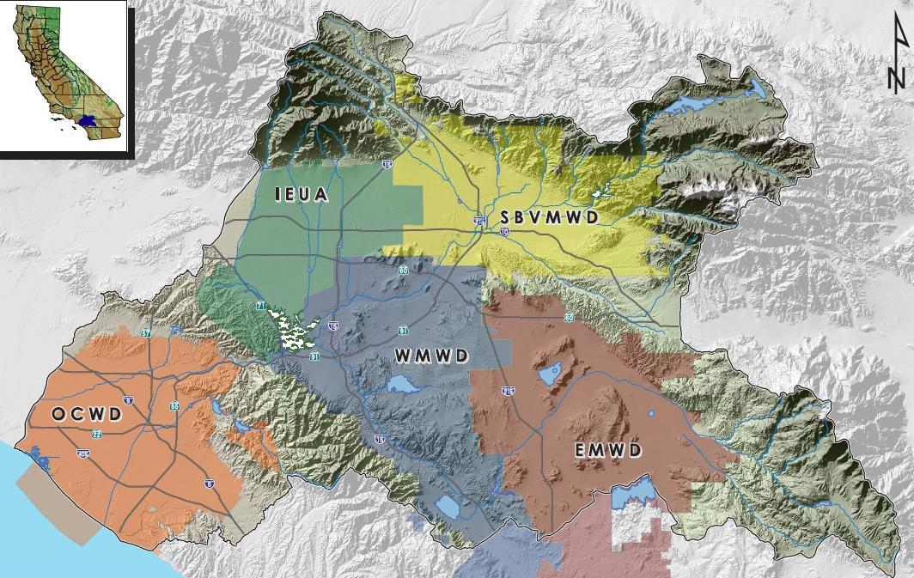
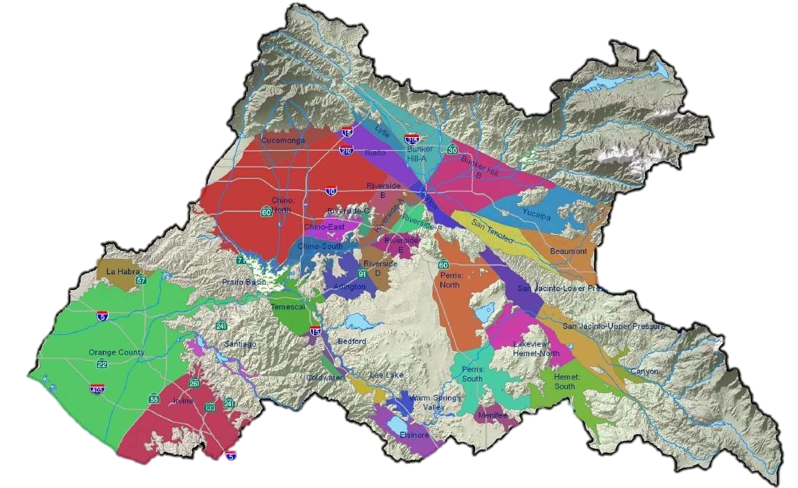
Study Objectives
CHINO
BASIN
Develop updated modeling for the Chino Basin
Define planning scenarios
Evaluate impacts from climate change
Use updated modeling tools to project the water quality concentrations
Perform antidegradation analysis
Use results to develop and finalize a regulatory compliance strategy
Amend the Basin Plan to incorporate updated requirements
Notes:
IEUA, CBWM, West Yost and the Regional Water Quality Control Board began this effort in 2016.

Slide 25
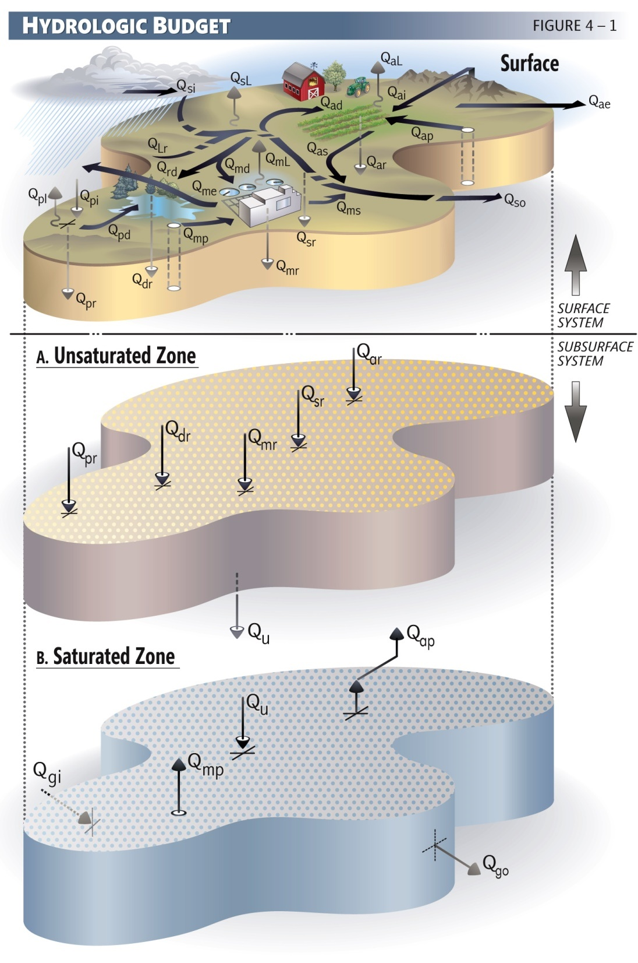
Methodology to Evaluate Impacts of Salinity Management Scenarios
Define
Define the TDS and nitrate loading
Establish
Establish an initial condition in the aquifer system
Define
Define salinity management scenarios and the criteria for evaluation
Estimate
Estimate future TDS and N impacts using a series of water quality models

Slide 26
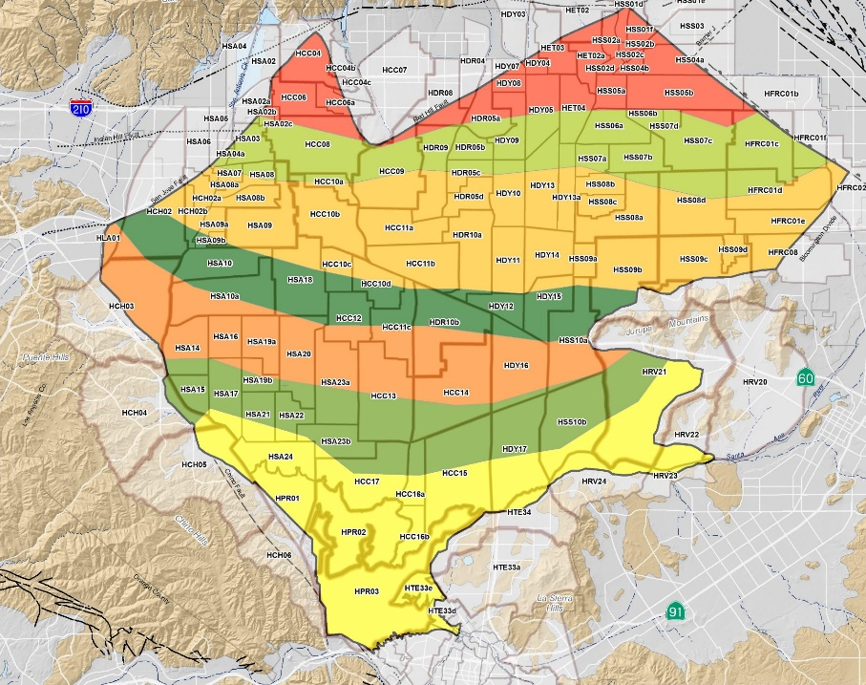
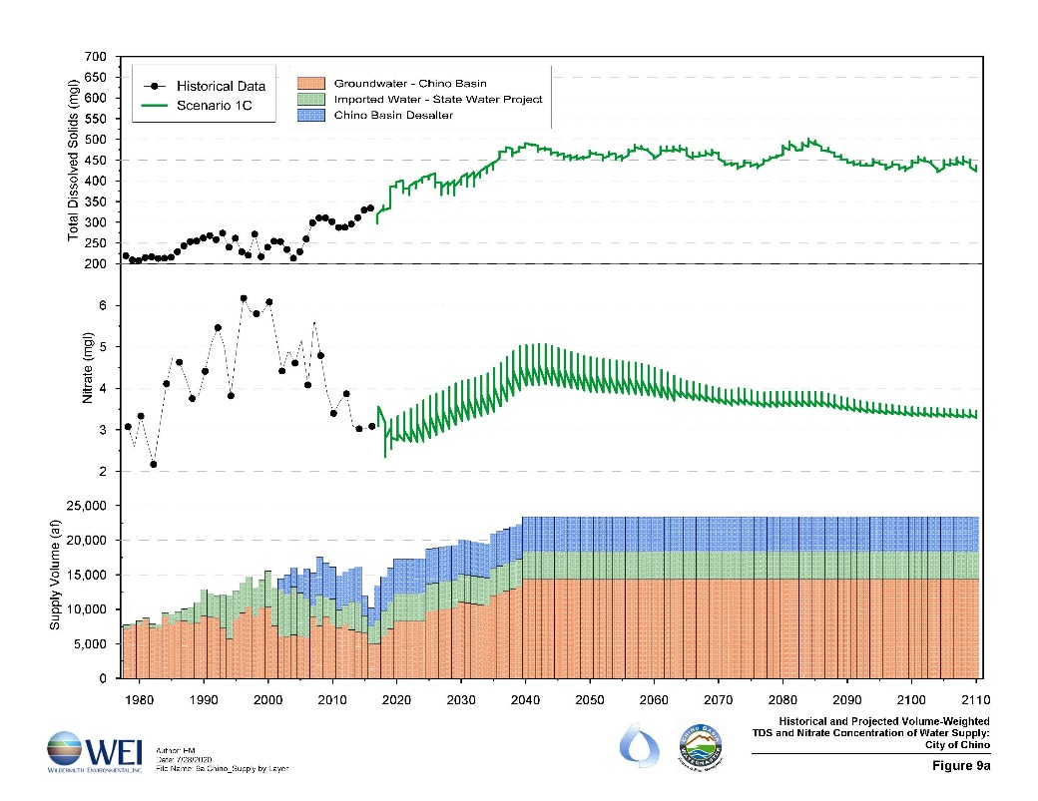
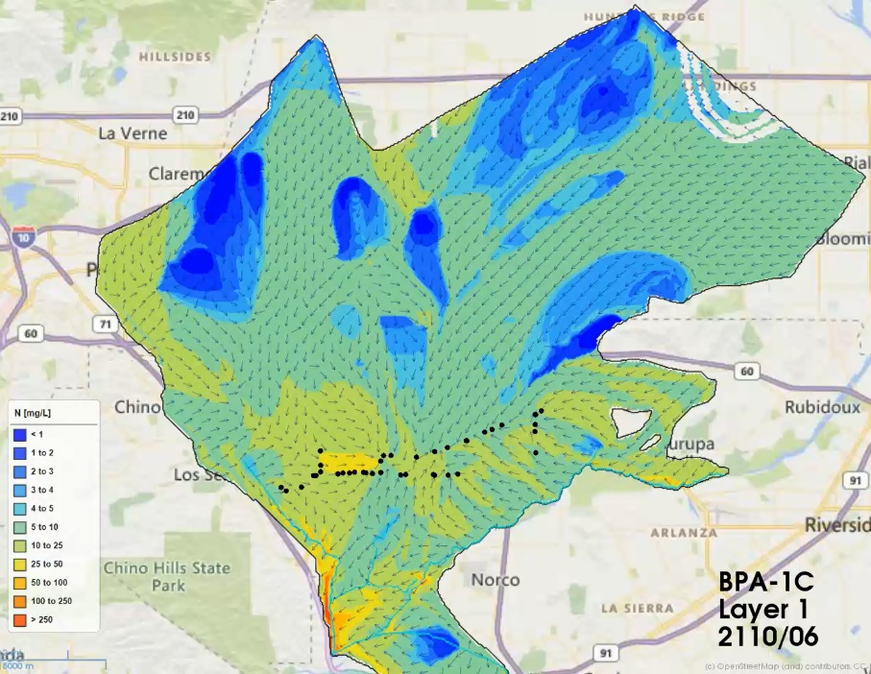
Study Progress
Work completed:
Finalized proposed methods for modeling with RWQCB
Constructed and integrated models
Developed groundwater and vadose zone initial conditions
Defined and calculated the Baseline conditions
Prepared sensitivity analysis
Upcoming effort:
Finalize planning scenarios
Produce and analyze modeling results
Future planning for Advanced Water Purification Facility
Continue working with the RWQCB to update permit
Notes:
Together, CBWM, WEI and IEUA have undertaken a project to prepare groundwater basin modeling for TDS
The project will update the groundwater modeling for the Chino Basin to include future salinity projects, source water forecast, and groundwater conditions.
The effort will support obtaining approval for a Basin Plan amendment and permit modifications

Slide 27
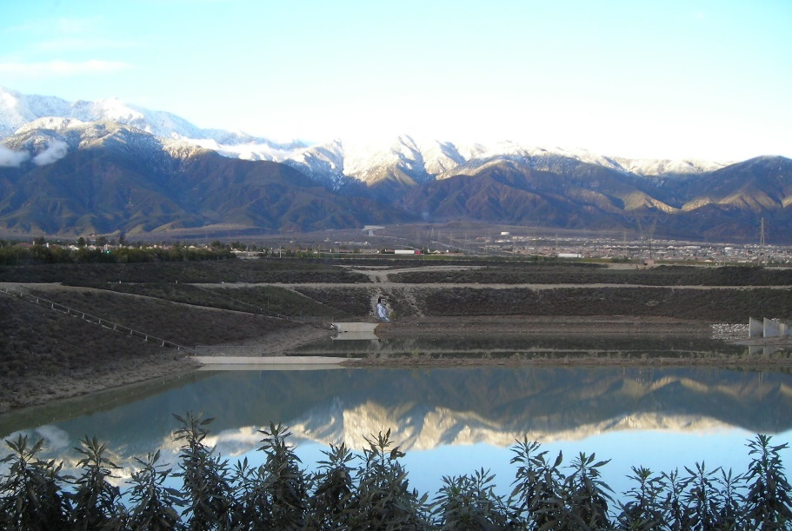
Hands-on Regional Salinity Management
Goals for long-term optimum basin management
Extensive stakeholder coordination
Close and consistent coordination with the RWQCB
Recycled and groundwater are essential Chino Basin water supplies
Collaboration and partnerships are key to regional success
Notes:
IEUA is a steward of the region, responsible for managing water/wastewater
Coordination is key: held over 20 workshops related to salinity in recycled water since 2014
Critical to evaluate challenges and develop long-term solutions together
There’s an important nexus between compliance and water supply
Region has been hands-on in planning for and implementing salinity management programs

Slide 28
Thank you for the opportunity to share the Chino Basin approach to salinity management
Shivaji Deshmukh, General Manager
Inland Empire Utilities Agency
www.ieua.org
Peter Kavounas, General Manager
Chino Basin Watermaster
www.cbwm.org

